Slide 1
IoT-Based Water Quality Monitoring System.
Group No 11.
Roll No:
21,28,29,31
Guide : Prof. Sachin Kamble
For Safe Drinking Water.

Slide 2
Problem Statement
Developing an Integrated Sensor-Based River Water Quality Monitoring System for Drinking.
In modern agriculture, the quality of water used for irrigation plays a crucial role in determining crop yield and overall agricultural productivity. However, the lack of a real-time and comprehensive water quality monitoring system for assessing key parameters such as pH, ORP, conductivity, dissolved oxygen, residual chlorine, turbidity, and salinity in river water poses a significant challenge to farmers. Traditional methods of water quality testing are often time-consuming, labor-intensive, and may not provide immediate results. The objective of this project is to design and implement an Internet of Things (IoT) based water quality monitoring system using various sensors, including pH, ORP, conductivity, dissolved oxygen, residual chlorine, turbidity, and salinity sensors. The system will be integrated with an Arduino board to provide farmers with real-time information about the suitability of river water for irrigation purposes.

Slide 3
Motivation
The motivation behind this project stems from the urgent need to address the critical challenges faced in agricultural water management. As global populations continue to grow and environmental concerns intensify, sustainable agricultural practices have become paramount. Access to clean and suitable water for irrigation plays a pivotal role in ensuring optimal crop yield, maintaining soil health, and mitigating environmental impacts.
However, many regions grapple with the issue of water contamination, which can lead to diminished crop quality, reduced yield, and even soil degradation. Traditional methods of water quality assessment are often time-consuming, expensive, and lack real-time capabilities, making it difficult for farmers to make informed decisions about irrigation water usage.
Source: Water Quality (who.int) , WHO 2022 Analysis.

Slide 4
Abstract
Sustainable agricultural practices hinge on efficient water management, and the quality of irrigation water is pivotal in ensuring optimal crop yield and environmental preservation. This project presents an innovative solution to address this challenge through the integration of advanced sensors and technology. By employing a range of sensors, including pH, ORP, conductivity, dissolved oxygen, residual chlorine, turbidity, and salinity sensors, the project aims to comprehensively evaluate the quality of river water used for irrigation. The data collected by these sensors will be processed in real-time using an Arduino board, enabling immediate assessments of water suitability for irrigation.
The potential impact of this project includes enhanced crop yield, resource efficiency, and reduced environmental risks associated with water contamination. By providing a reliable tool for evaluating irrigation water quality, the project strives to contribute to sustainable agricultural practices, resilient food production, and environmental conservation.

Slide 5
Proposed Solution :
By developing this system, we aim to address the following key challenges:
Real-time Monitoring: Create a system that continuously monitors multiple water quality parameters, ensuring that farmers have access to real-time data on river water conditions.
Sensor Integration: Develop a solution to seamlessly integrate pH, ORP, conductivity, dissolved oxygen, residual chlorine, turbidity, and salinity sensors into a single monitoring unit.
Data Analysis and Interpretation: Implement algorithms and processing techniques to analyze sensor data and provide an easy-to-understand assessment of water quality, indicating whether the water is safe for irrigation or not.
User-Friendly Interface: Design an intuitive user interface that displays the water quality parameters and corresponding safety status, allowing farmers to make informed decisions regarding irrigation practices

Slide 6
Proposed Solution :
5. Alert System: Implement an alert mechanism that notifies farmers in real-time through visual indicators or notifications on their devices if the water quality falls below acceptable levels
6. Cost-Efficiency and Scalability: Develop a cost-effective solution that can be easily replicated and scaled to suit different agricultural settings and water sources.

Slide 7
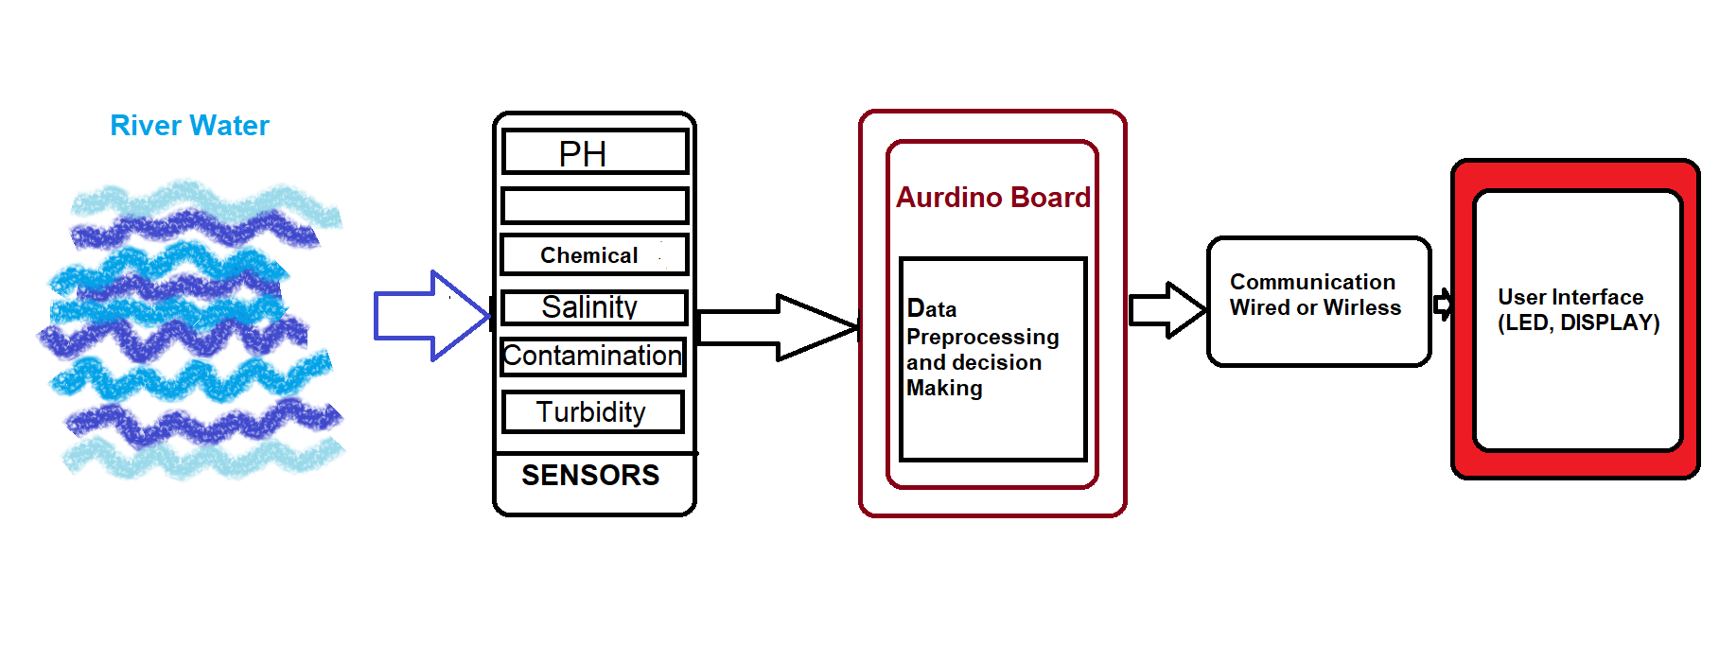
Basic Architecture

Slide 8
Basic Architecture explanation.
River Water: This is the water source from which you're drawing water for irrigation.
Sensors: These sensors (pH, ORP, conductivity, etc.) are placed in the river water to measure various water quality parameters.
Arduino Board: The Arduino board processes the data from sensors and makes decisions based on predefined thresholds or criteria. It determines whether the water is safe for irrigation.
Communication: The Arduino board communicates with external systems, which could be wired or wireless. It transmits the sensor data and irrigation suitability decisions.
User Interface: The results are displayed to the user through LEDs, a display on the device, or even a mobile app. This informs users about the quality of the water and whether it's suitable for irrigation.

Slide 9
Existing Solutions.
Traditional Water Testing: Farmers and agricultural organizations often rely on traditional water testing methods, which involve collecting water samples and sending them to laboratories for analysis. While accurate, this process can be time-consuming and lacks real-time information.
Portable Water Testing Kits: Portable water testing kits have been developed that allow farmers to conduct basic water quality tests on-site. These kits include test strips or color-changing reagents that indicate the presence of specific contaminants.
Mobile Apps: Mobile applications have been developed that allow users to input water quality data and receive instant feedback on water suitability for irrigation. These apps often use established water quality guidelines to make assessments.

Slide 10
References:

Slide 11
Thank You.

